Slide 1
19I720 - PROJECT PHASE - I
KNOWLEDGE DISTILLATION BASED FEAR LEVEL
DETECTION IN HUMANS USING DEEP LEARNING
BATCH - 2
Project Guide:
Dr. B.Vinoth Kumar
Professor
Department of Information Technology
PSG College of Technology
Coimbatore.
Team Members:
21I309 - Dharneesh R
21I341 - Pranavraja S
21I354 - Selvakumar T
22I466 - Riswanth N

Slide 2
Agenda
Introduction
Literature Survey
Dataset Analysis
Gaps Identified
Proposed Methodology
Block Diagram
Implementation and Result
Requirements
References

Slide 3
Problem Statement
Current emotion recognition models using EEG and ECG signals suffer from limited accuracy and poor generalization, making them unreliable for real-world applications in affective computing and biomedical signal processing.
There is a need to develop improved methodologies that enhance the performance of these models, making them more accurate and generalizable across different datasets and populations.

Slide 4
Problem Definition
Emotion recognition using physiological signals such as EEG and ECG is crucial for monitoring both physiological and psychological states.These measurements are essential for applications in affective computing and biomedical signal processing.
Existing methods for emotion recognition face significant challenges, including limited accuracy and poor generalization of current models.
This project aims to improve the accuracy and generalization of emotion recognition models using EEG and ECG data.
Leveraging the DEAP dataset, which includes recordings from 32 participants, various deep learning models will be compared.
The process involves data preprocessing, and model application.
Performance will be evaluated using metrics like accuracy, precision, recall, and F1-score, with the goal of advancing methodologies in affective computing and biomedical signal processing.

Slide 5
Objectives
To enhance the accuracy and generalizability of fear detection using computational intelligence.
To implement a comprehensive strategy that includes exploring ensemble and hybrid models, integrating multimodal data and preprocessing techniques, and ensuring model robustness across diverse datasets.
This approach is designed to address existing gaps in the current solutions and push the boundaries of fear detection technology.

Slide 6
Literature Survey
S.NO | PAPER | DATASET | MODELS | INPUTS | INFERENCE | ACCURACY
1 | Title "Multi-Input CNN-LSTM deep learning model for fear level classificati signals” Author - Nagisa Masuda Eguchi Yarı, Frontiers in Psychology, Year 2023 | DEAP Dataset | CNN LSTM | EEG Signals | The study employed a Multi-Input CNN-LSTM model to accurately estimate fear levels from multichannel EEG and peripheral physiological signals. | 97%
2 | Title "Multi-Domain Feature Fusion for Emotion Classification Using DEAP Dataset" Author-Mohammed,Syed Mohammed, Ieee Access, Year 2021 | DEAP Dataset | SVM LOOCV | EEG Signals | This study introduces a real-time EEG-based emotion recognition applicability to a broader emotional spectrum. | 65%
3 | Title “EEG-induced Fear-type Emotion Classification Through WPD, WE, and SVM”, Authors - Caglar Uyulan,Ahmet Ergun Gumus, Zozan Guleken Hittite Journal of Science and Engineering, Year - 2022 | Brain Wave Dataset. | SVM RF LSTM | EEG ,HR Signals | The models are trained and tested in both user dependent and user-independent models are selected for further testing. | 94%

Slide 7
Cont.,
4 | Title”Multi-Domain Feature Fusion for Emotion Classification Using DEAP Dataset” Authors Digital Object Identifier M. Alarcao, and Manuel J. Fonseca, Ieee Access, Year 2021 | DEAP Dataset | SVM | EEG Signals | Classification model achieved the highest (with Hjorth and classification on DEAP dataset to the best of our knowledge. | 94%
5 | Title “Emotions Recognition Using EEG Signals”: Author Soraia M. Alarcao, and Manuel J. Fonseca, ̃ Senior Member, IEEE transactions on affective computing, Year 2020 | MAHNOB Dataset | LSTM SVM | GSR EMG HR Signals | The propose novel methods for the recognition of emotions from EEG (e.g., subjects, features extracted, classifiers, etc.). | 82%
6 | Title: “Stress Detection with Machine Learning and Deep Learning Using Multimodal Data” Author Sorasa M. Alarcao, and Manuel J. Fonseca, (ICIRCA). IEEE, Year 2020 | DEAP Dataset | RNN LSTM GRU | EEG Signals | The most used feature selection algorithms are (PCA), (SFS), Model of Affect—valence, arousal, dominance, liking etc. | 95%

Slide 8
Cont.,
7 | Title”An Investigation of Various Automatic Fear Detection Authors: Oana Bălan, Gabriela Moise, Alin Moldoveanu, Sensors, Year 2020 | MAHNOB Dataset | SVM, Decision Tree, Random Forest | EEG, HR,GSR Signals | The Method defines a complex emotion such as fear as a combination of the data into low or high valence, arousal and dominance. | 89%
8 | Title”An Investigation of Various Machine and Deep Learning in Fear Authors - Oana Bălan , Gabriela Moise , Alin Moldoveanu, Sensors, Year 2020 | DEAP Dataset | SVM RF LDA | EEG Signals | The study employed a VR system that captures levels and predict appropriate exposure scenarios. cross-validation and test accuracies. | 79%
9 | Title: “Comparative Analysis of machine learning using EEG Author Vikrant Doma and Matin Pirouz Journal of Big Data, Year 2020” | DEAP Dataset | SVM KNN | BEG and Peripheral Physiological signals | The study utilized machine learning models like SVM, KNN, Logistic Regression, and preprocessing for improved emotion recognition accuracy. | 75%

Slide 9
Cont.,
10 | Title: “EmotionKD:A Cross-Modal Knowledge Distillation Framework for Emotion Recognition Based on Physiological Signals​”, Proceedings of the 31st ACM International Conference on Multimedia, Year 2023 | DEAP Dataset | EmotionNet-Teacher (multimodal) and EmotionNet-Student (unimodal)​ | EEG and GSR signals​ | Knowledge distillation transfers fused multi-modal EEG and GSR features to a unimodal GSR model for better emotion recognition | 69.18%

Slide 10
Dataset Analysis
Name: DEAP Dataset
Purpose: Emotion analysis and classification using physiological signals.
Dataset Type: Multimodal physiological dataset (EEG, EMG, GSR, ECG, etc.)
Size: 1.9 GB
Participants: 32 subjects (16 males, 16 females).
Recording Duration: Each participant’s EEG signals were recorded for 63 seconds per video clip (60 seconds of stimuli and 3 seconds pre-trial baseline).
Sampling Rate: 512 Hz (downsampled to 128 Hz for preprocessed data).
Total Data Points: 32 participants × 40 video trials per participant = 1,280 trials.

Slide 11
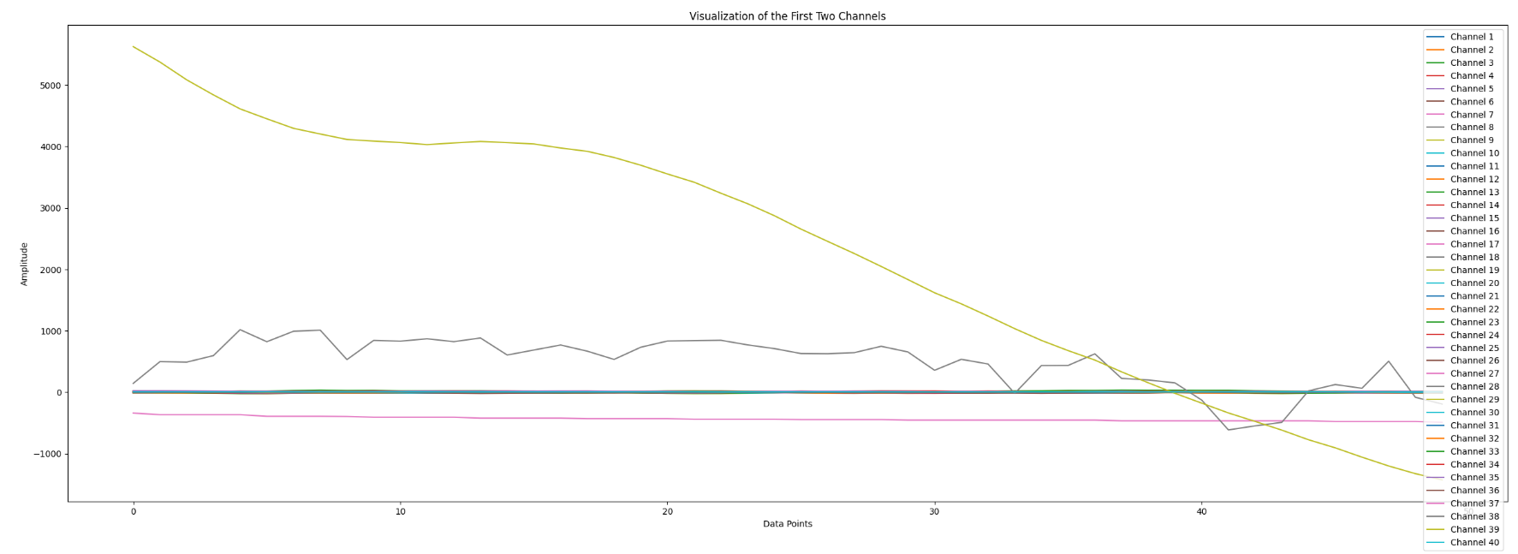
Dataset Analysis

Slide 12
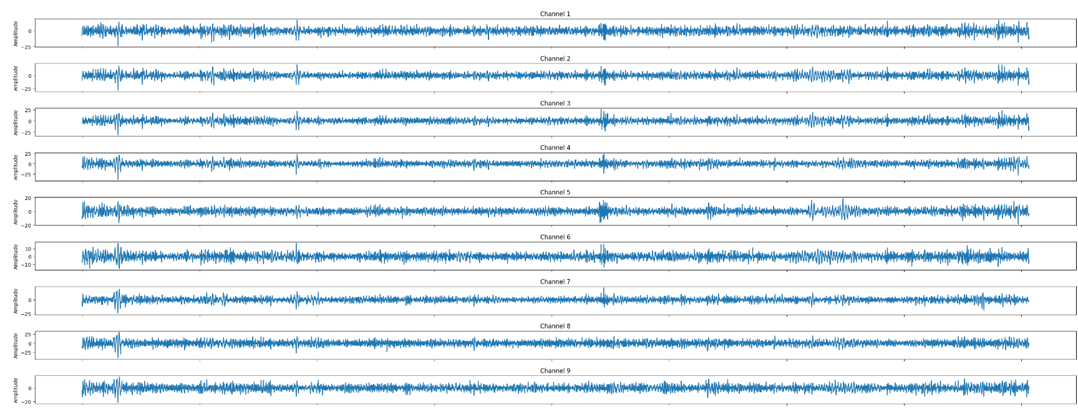
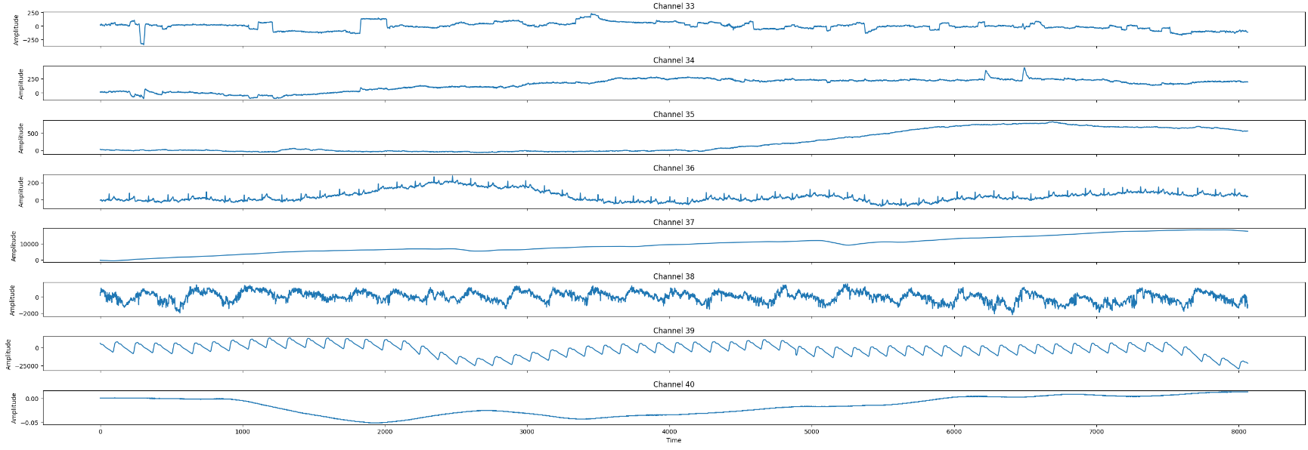
Dataset Analysis

Slide 13
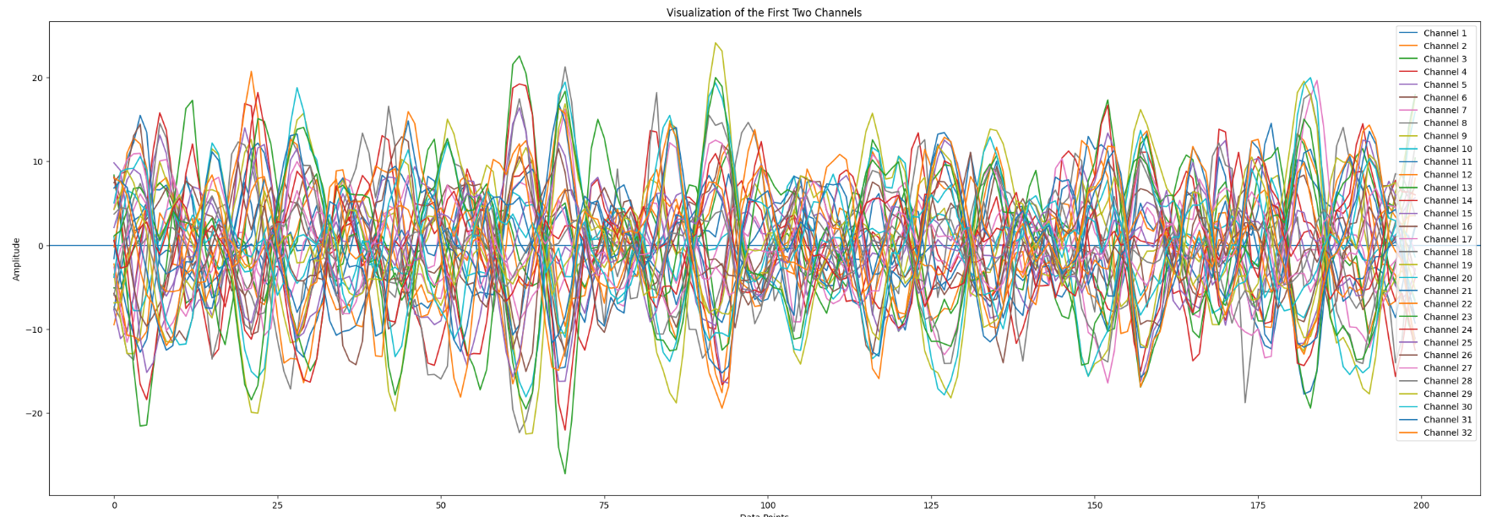
Dataset Analysis

Slide 14
Problems with the DEAP Dataset
The channels are of not in uniform range
Range[-0.05 to 0.05] - channels [40]
Range[-10 to 10] - channels [6, 10, 15, 16, 27, 28]
Range[-20 to 20] - channels [5, 9, 12, 14, 23, 30, 32]
Range[-25 to 25] - channels [1, 2, 3, 4, 7, 8, 11, 13, 17, 18, 19, 20, 21, 22, 25, 26, 29, 31]
Range[-50 to 50] - channels [24]
Range[0 to 200] - channels [36]
Range[-250 to 250] - channels [33,34]
Range[0 to 500] - channels [35]
Range[-2000 to 2000] - channels [38]
Range[0 to 20000] - channels [37]
Range[-25000 to 25000] - channels [39]
Hence to bring them into a uniform range of [0-1], normalization[Min-Max] is applied.

Slide 15
Division of valence, arousal and dominance for the four-level fear evaluation modality
Label | Valence | Arousal | Dominance
No Fear (0) | [7:9] | [1:3) | [7:9]
Low Fear (1) | [5:7) | [3:5) | [5:7)
Medium Fear (2) | [3:5) | [5:7) | [3:5)
High Fear (3) | [1:3) | [7:9] | [1:3)

Slide 16
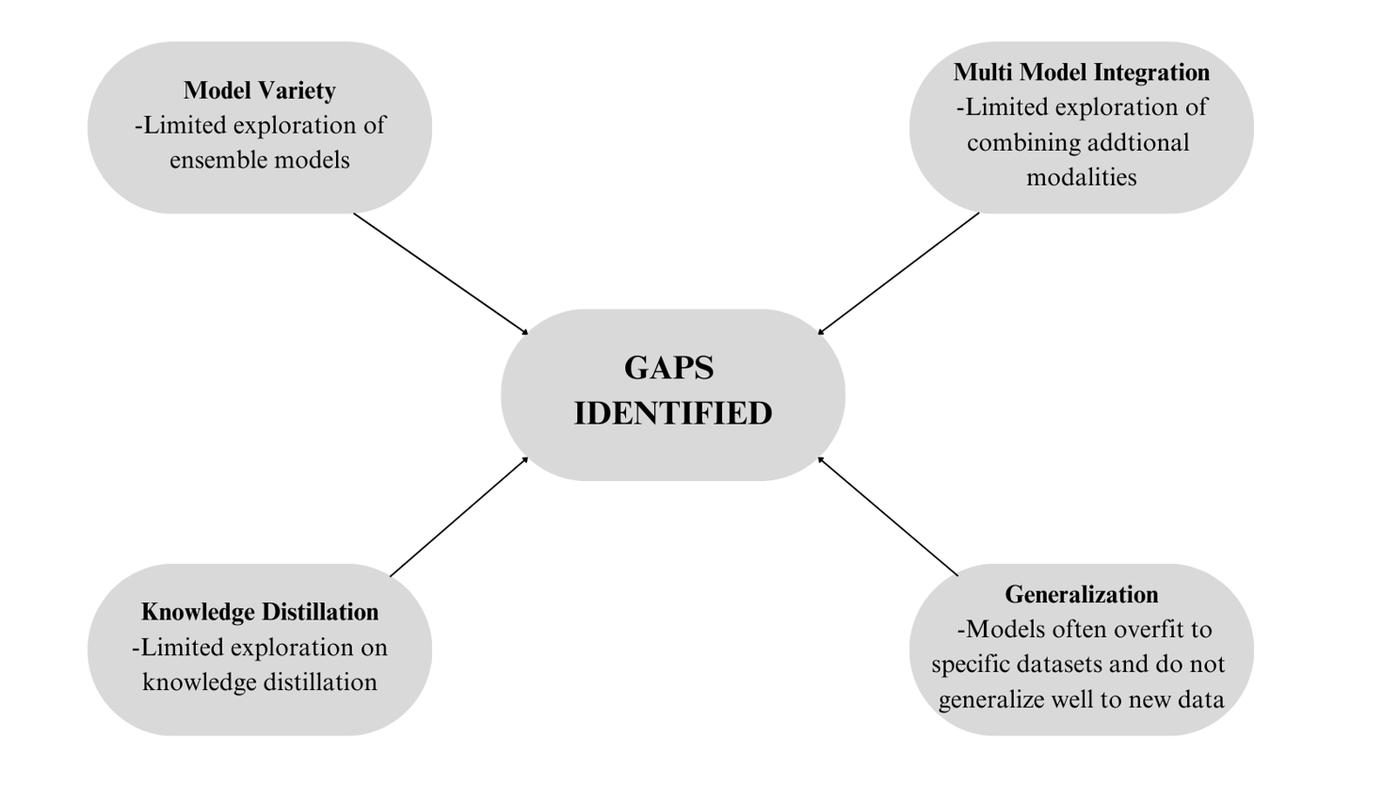
Gaps Identified

Slide 17
Proposed Methodology
Model Variety: Exploring Ensemble and Hybrid Models
To leverage the strengths of multiple models to improve prediction accuracy.
Develop hybrid models combining different types of neural networks (e.g., combining CNNs for spatial data with RNNs for temporal data).
Compare the performance of these models using cross-validation to ensure robust evaluation.
Multi-Modal Integration: Combining Additional Modalities
To improve model performance by integrating data from multiple sources, such as EEG, ECG, and other physiological signals(hEOG,vEOG,zEMG,GSR, Respiration, PPG, Temperature).
Implement multi-input models that can process and integrate these different data sources.
Evaluate the impact of multi-modal integration on model performance.

Slide 18
Proposed Methodology
Knowledge Distillation: Teacher-Student Approach
Knowledge distillation allows smaller models to effectively learn from large, complex teacher models.
Fewer input channels in student models reduce computational load, enabling faster, efficient real-time applications with cost effectiveness
Generalization: Ensuring Robustness Across Diverse Datasets
To develop models that generalize well to new, unseen data.
Fine-tune models on different datasets without losing generalizability.

Slide 19
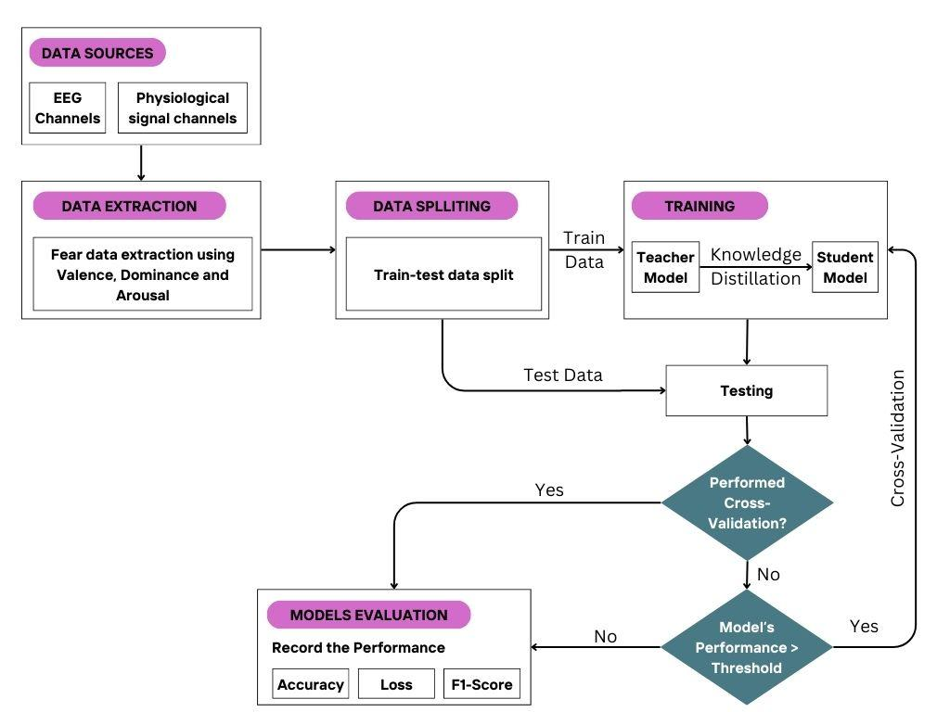
Block diagram

Slide 20
Knowledge Distillation
Knowledge distillation is a technique in machine learning where a smaller, simpler model (called the student model) is trained to mimic the behavior of a larger, more complex model (called the teacher model).
Key components of knowledge distillation:
Teacher Model: A large (in terms of layers, parameters and inputs), complex and accurate model.
Student Model: A smaller, efficient model replicating the teacher.
Soft Targets: The student learns from the teacher’s output probabilities, not just class labels.
Hard Loss: Measures the difference between the student model's predictions and the true labels, ensuring the student learns from both soft teacher outputs and ground truth.
Loss Function: Combines standard loss (e.g., cross-entropy) and distillation loss to match the teacher’s output.

Slide 21
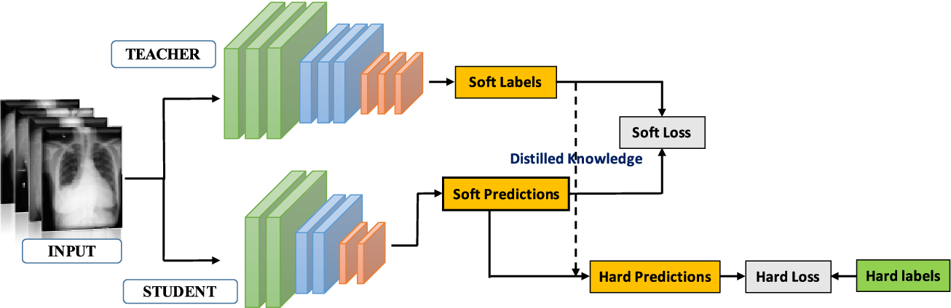
Knowledge Distillation
Flow Diagram:

Slide 22
Details of Layers used in each model
The layers used in the models:
Dense(Fully Connected) Layers - Each neuron is connected to every other neuron in the previous and next layers.
LSTM Layer - Gates: Input gate, forget gate, and output gate control the flow of information.
Conv1D/Conv2D Layers - Extract features from the input by sliding filters (kernels)
Pooling Layers - Reduces the dimensionality of the output
Flatten Layer - Converts multi-dimensional data into a 1D vector to feed into dense layer.
Activation Functions Used:
ReLU (Rectified Linear Unit) - It outputs the input directly if it is positive; otherwise, it outputs zero.
Softmax - Normalizes the output into a probability distribution over multiple classes.

Slide 23
Details of Layers used in each model
Loss Functions Used:
Categorical Cross-entropy - Measures the difference between the true label (one-hot encoded) and the predicted probability distribution.
Loss = −∑​yi​log(yi​`)
Sparse Categorical Cross-entropy - Used when the labels are not one-hot encoded.
Soft Loss (Distillation Loss) - helps the student model learn from the teacher model's softer predictions (i.e., probabilities)
Soft Loss = CrossEntropy(Teacher Predictions (softened),Student Predictions (softened))
Hard Loss - Allows student model to learn directly from the ground-truth labels(true class labels)
Combined Loss - Soft and hard losses are typically combined using a weighting factor α
Total Loss = α⋅Soft Loss + (1−α)⋅Hard Loss

Slide 24
Details of Layers used in each model
Adam Optimizer (Adaptive Moment Estimation):
Combines the advantages of two other optimizers: AdaGrad and RMSProp.
Adapts the learning rate individually for each parameter by calculating first and second moments (mean and variance) of the gradients.
First Moment (m): The exponentially decaying average of the gradient (like momentum).
Second Moment (v): The exponentially decaying average of the squared gradient (similar to RMSProp).
Other Hyperparameters:
Temperature - controls the softness of the teacher model's output probabilities (logits) when generating soft labels.
Alpha (α)- controls the balance between the distillation loss (soft labels from the teacher) and the hard loss (true labels).

Slide 25
Code Structure
teacher_model = create_teacher_model()
teacher_model.fit(X_train, y_train, epochs=100, batch_size=32)
# Generate soft targets from Teacher Model for Student Training
soft_targets = teacher_model.predict(X_train)
# Train Student Model using soft targets from Teacher Model
student_model = create_student_model()
student_model.fit(X_train[:, -8:], soft_targets, epochs=100, batch_size=32)
# Evaluate Student Model on Test Data
test_soft_targets = teacher_model.predict(X_test)
student_loss_and_metrics = student_model.evaluate(X_test[:, -8:], test_soft_targets)
# Get teacher model predictions (soft labels)
teach_logits = teacher_model ([X_train_fold[i:i+batch_size]], training=False)
teach_probs = tf.nn.softmax(teach_logits / temp)
# Get student model predictions
stud_logits = student_model(X_batch, training=True)
stud_probs = tf.nn.softmax(stud_logits / temp)
# Distillation loss
distil_loss = tf.reduce_mean( losses.categorical_crossentropy(teach_probs, stud_probs))
hard_loss = tf.reduce_mean(losses. categorical_crossentropy(y_batch, stud_logits))
# Combined loss
loss = alpha * distil_loss + (1 - alpha) * hard_loss

Slide 26
Comparison of Models with KD
Both Teacher and Student models are trained for 100 epochs, and student model has reduced parameters (para.) and inputs. Threshold - accuracy > 60%.
Model Name | With Knowledge Distillation
 | Teacher Model |  |  | Student Model
 | Channels | Para. | Testing Accuracy (%) | Stud. Model | Channels | Para. | Without KD Test Acc. (%) | With KD Test Accuracy (%)
ANN | 40 | 4,836 | 57.51 | ANN | 8 | 420 | 45.38 | 49.71
DNN 150 | 40 | 52,054 | 69.94 | DNN 150 | 8 | 24,604 | 67.73 | 58.09
DNN 300 | 40 | 374,704 | 69.36 | DNN 300 | 8 | 274,804 | 63.29 | 61.27
LSTM | 40 | 19,572 | 51.16 | LSTM | 8 | 4,948 | 48 | 48
CNN-LSTM Hybrid | 40 | 148,996 | 91.33 | DNN 300 | 8 | 184,504 | 63.29 | 64.45
 |  |  |  | LSTM | 8 | 35,684 | 48 | 51.73
TCN | 40 | 875,342 | 92.03 | TCN | 8 | 150,158 | 79.19 | 76.01

Slide 27
Comparison of Models with KD
Cross Validation (C.V. - 5 fold) done for DNN 300, CNN-LSTM Hybrid and TCN due to their best performance. Also KD was applied on Student Model with 40 channels(Ch.) as inputs.
Model Name | With Knowledge Distillation
 | Teacher Model |  |  | Student Model
 | Ch. | Para. | Testing Accuracy (%) | Model | Ch. | Para. | Without KD Test Acc. (%) | With KD Test Acc. (%)
DNN 300 | 40 | 1,124,114 | 75.43 | DNN 300 | 8 | 824,414 | 73.41 | 70.23
 |  |  |  |  | 40 | 853,214 | 75.43 | 73.12
CNN-LSTM Hybrid | 40 | 446,990 | 91.90 | DNN 300 | 8 | 184,504 | 53.17 | 54.62
 |  |  |  |  | 40 | 382,314 | 53.75 | 55.49
TCN | 40 | 875,342 | 92.03 | TCN | 8 | 88,910 | 76.30 | 77.16
 |  |  |  |  | 40 | 814,094 | 89.1 | 93.03

Slide 28
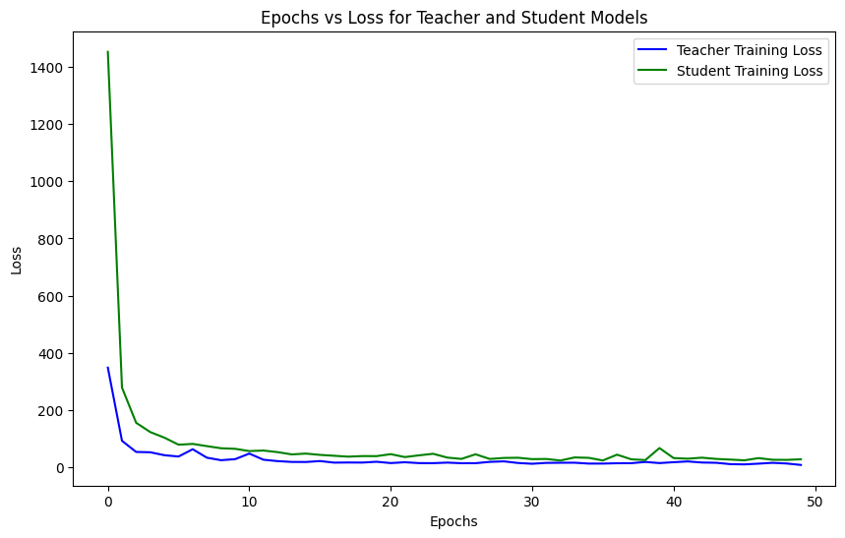
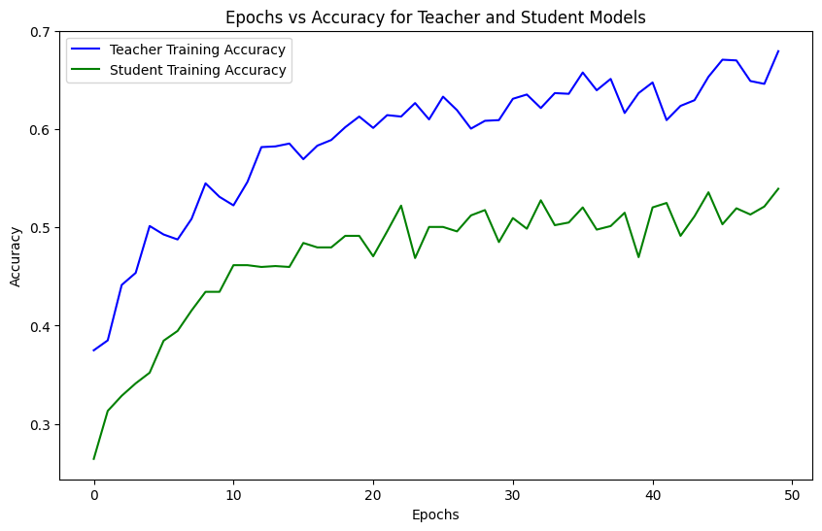
Result Analysis
Using simple neural network model, where the teacher is trained with 40 input channels and the student model is trained with 8 physiological signals:

Slide 29
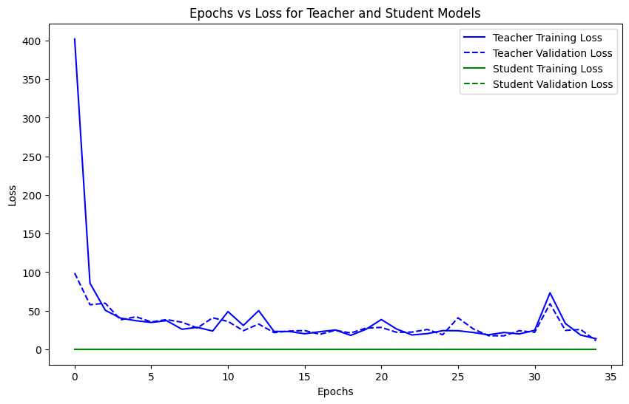
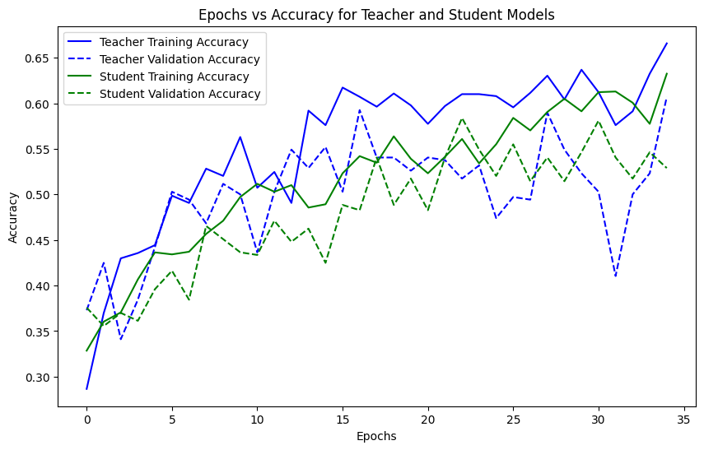
Result Analysis
Simple ANN with both Teacher and Student as 40 Channels:

Slide 30
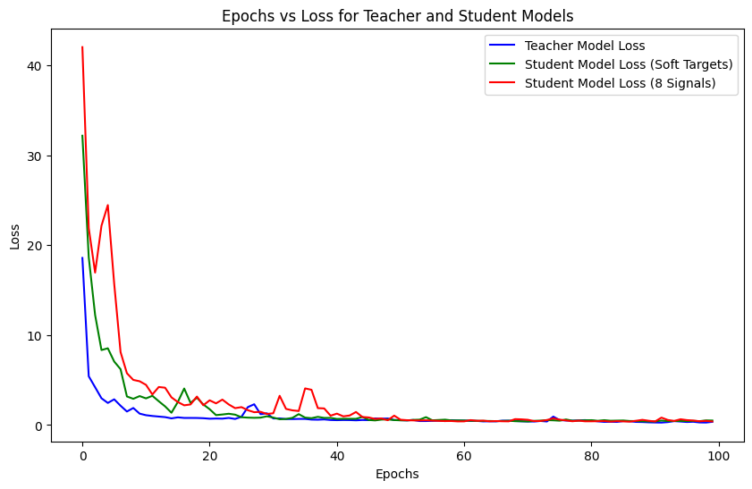
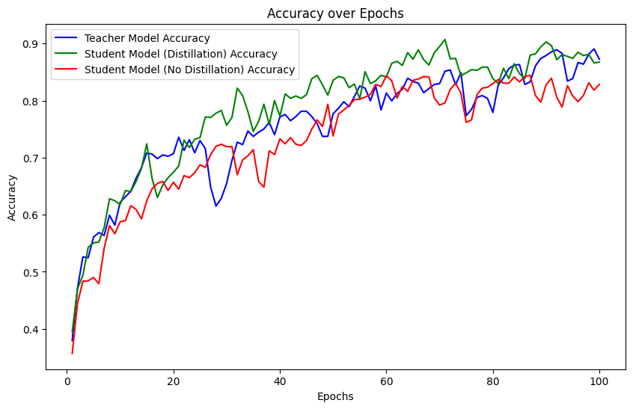
Result Analysis
Using DNN 150 model teacher - 40 channels Student - 8 physiological signals:

Slide 31
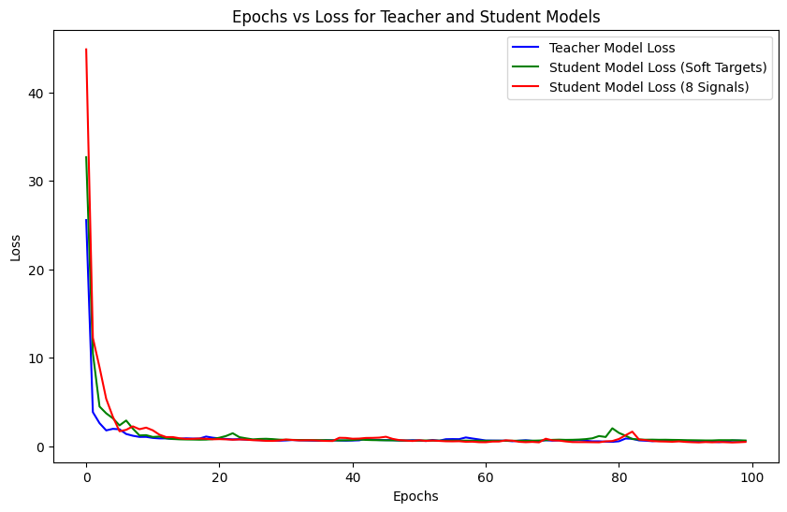
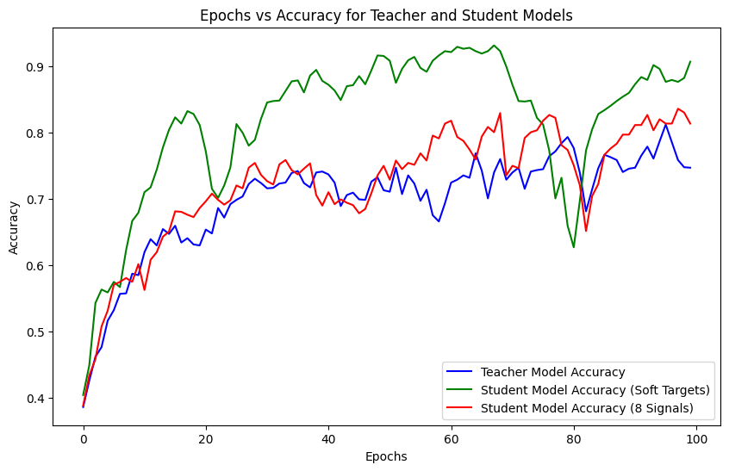
Result Analysis
Using DNN 300 model teacher - 40 channels Student - 8 physiological signals:

Slide 32
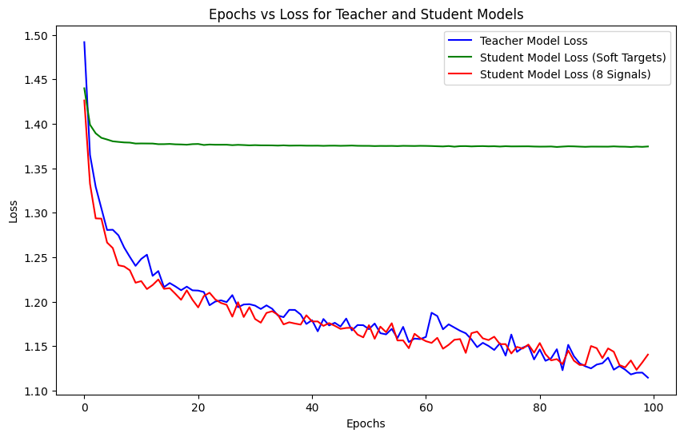
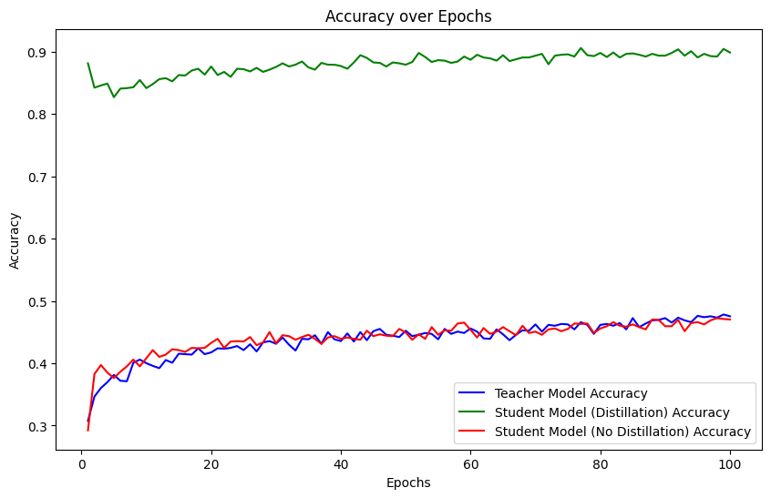
Result Analysis
Using LSTM model teacher - 40 channels Student - 8 physiological signals:

Slide 33
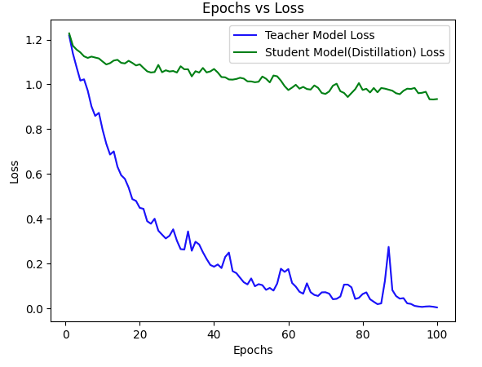
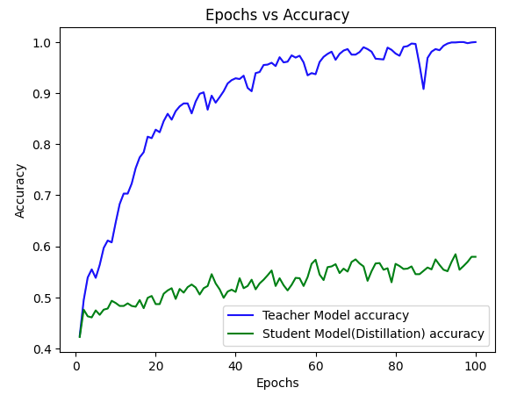
Result Analysis
Using CNN-LSTM model teacher - 40 channels Student - 8 PPS signals:

Slide 34
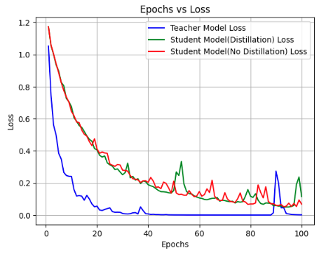
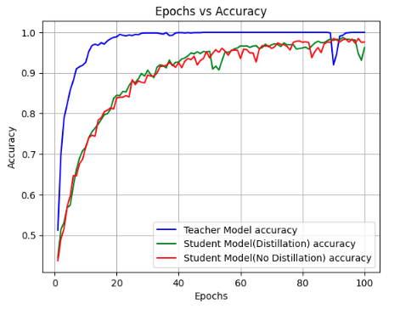
Result Analysis
Using TCN model teacher - 40 channels Student - 8 physiological signals:

Slide 35
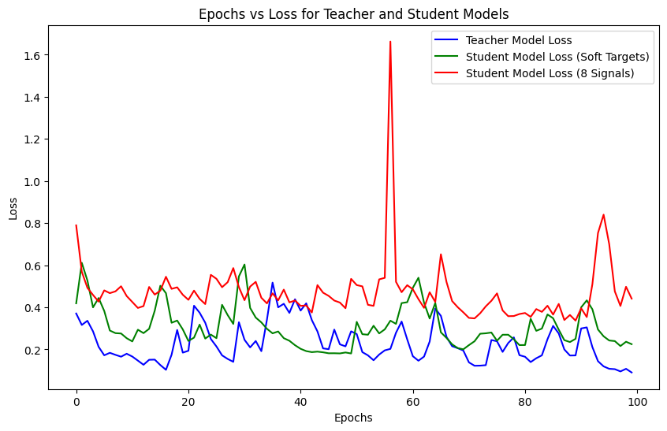
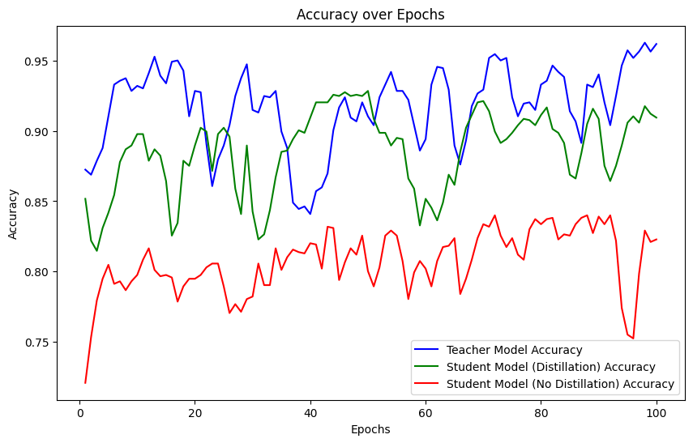
Result Analysis
Using DNN 300 model teacher - 40 channels Student - 8 physiological signals with cross validation:

Slide 36
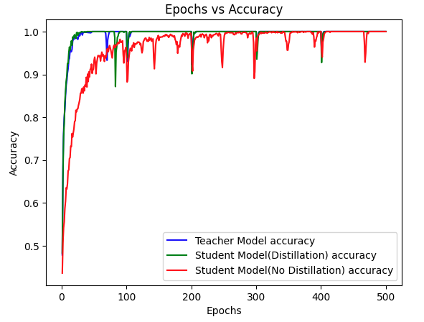
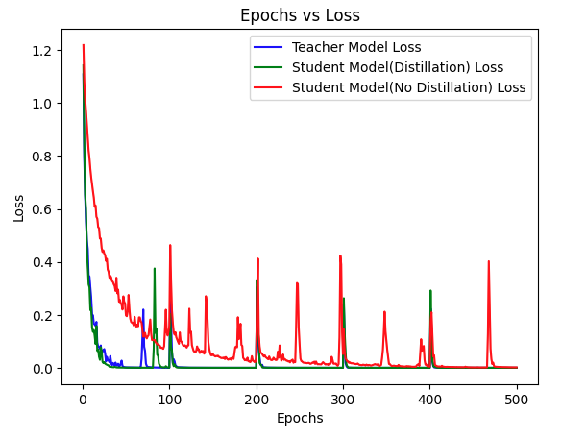
Result Analysis
Using Cross fold validation TCN model teacher - 40 channels Student - 8 signals:

Slide 37
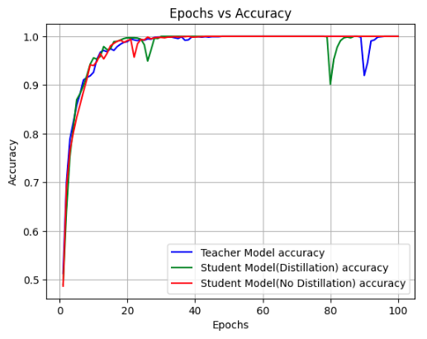
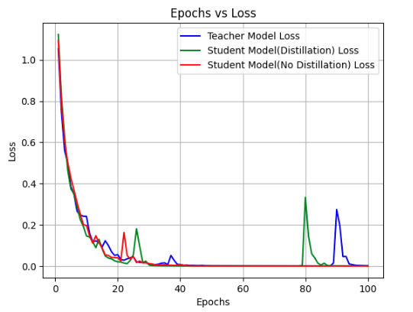
Result Analysis
Using TCN model teacher - 40 channels Student - 40 signals cross validation:

Slide 38
Requirements
Hardware Requirements
Processor: Intel i5 series
RAM: 16 GB/32 GB
GPU: 4 GB
Software Requirements
Operating System: Windows 11
Programming Language: Python 3.8
Packages: Pytorch, Matplotlib, TensorFlow, Pandas, Scikit-learn, NumPy, Seaborn, Git
IDE: Google Colaboratory
Dataset
DEAP- Dataset for Emotional Analysis using Physiological signals.

Slide 39
Comparison of Existing Work and Our Approach.
Existing work | Remarks
Exploration of Machine Learning and Deep Learning models with variety of models. | An accuracy of 95% was obtained, with complex model.
Limited exploration of Knowledge distillation on emotion recognition with DEAP dataset. | An accuracy of 69.18% was obtained, which is insufficient for detecting emotions in real-time or near-real-time scenarios.
Our Approach | Remarks
Explored knowledge distillation with various deep learning models and compared their results. | Achieved upto 93% of accuracy, with a smaller complex model (Student model) by consuming less time and resources.

Slide 40
Conclusion
The student model achieved the accuracy of the teacher model with fewer parameters, reducing prediction time and model complexity, making it more efficient.
The Temporal CNN architecture with 40 channels yielded the best results, with the student model achieving 93% accuracy.
Using CNN helped extract relevant features, substantially improving accuracy in fear level classification tasks.
Cross-validation helped boost model performance by increasing accuracy, particularly for hybrid models like CNN-LSTM.
ANN and LSTM models showed saturation in performance, even after applying cross-validation, indicating their limitations with the given data
Hybrid models like CNN-LSTM performed comparably better, effectively capturing both spatial and temporal features from the input data

Slide 41
Future Enhancements
Data augmentation, particularly through advanced techniques like Generative Adversarial Networks (GANs), could address the challenges associated with limited datasets. These methods can generate synthetic EEG data, increasing the robustness of the models.
Reorganize the dataset to accommodate various training methodologies. Tailor the dataset for specific models and techniques to maximize learning efficiency and outcome.
Enhance the model's robustness by training and testing it across multiple datasets. This approach ensures that the model generalizes well to new, unseen data, reducing the risk of overfitting to a specific dataset.
One significant area of exploration is the incorporation of additional features, such as multiscale and wavelet transform features. By employing multiscale entropy and fractal dimensions across various scales, it may be possible to gain a more detailed understanding of the complexity in EEG signals, thereby enhancing classification precision.

Slide 42
References
N. Masuda and I. E. Yairi, "Multi-Input CNN-LSTM deep learning model for fear level classification based on EEG and peripheral physiological signals," Frontiers in Psychology, vol. 14, art. no. 1141801, 2023. Frontiers Media. doi: 10.3389/fpsyg.2023.1141801.
M. Z. I. Ahmed, N. Sinha, E. Ghaderpour, S. Phadikar, and R. Ghosh, "A novel baseline removal paradigm for subject-independent features in emotion classification using EEG," Bioengineering, vol. 10, art. no. 54, 2023. MDPI. doi: 10.3390/bioengineering10010054.
O. Bălan, G. Moise, A. Moldoveanu, M. Leordeanu, and F. Moldoveanu, "An investigation of various machine and deep learning techniques applied in automatic fear level detection and acrophobia virtual therapy," Sensors, vol. 20, art. no. 496, 2020. MDPI. doi: 10.3390/s20020496.
A. Dziedzickis, A. Kaklauskas, and V. Bucinskas, "Human emotion recognition: review of sensors and methods," Sensors, vol. 20, art. no. 592, 2020. MDPI. doi: 10.3390/s20030592.
R. Ghosh, S. Phadikar, N. Deb, N. Sinha, R. Das, and E. Ghaderpour, "Automatic eye-blink and muscular artifact detection and removal from EEG signals using k-nearest neighbour classifier and long short-term memory networks," IEEE Sensors Journal, vol. 23, pp. 5422–5436, 2023. IEEE. doi: 10.1109/JSEN.2023.3237383.

Slide 43
References
X. Li, S. Chen, X. Hu, and J. Yang, “Understanding the disharmony between dropout and batch normalization by variance shift,” in Proceedings of the IEEE/CVF Conference on Computer Vision and Pattern Recognition (CVPR), Silver Spring, MD, USA, 2019, pp. 2682–2690. IEEE.
J. A. Miranda, F. C. Manuel, L. Gutiérrez-Martín, J. M. Lanza-Gutierrez, M. Portela-García, and C. López-Ongil, “Fear recognition for women using a reduced set of physiological signals,” Sensors, vol. 21, no. 5, Art. no. 5, 2021. MDPI. doi: 10.3390/s21051587.
L. Yang et al., “Edgetb: A hybrid testbed for distributed machine learning at the edge with high fidelity,” IEEE Transactions on Parallel and Distributed Systems, vol. 33, no. 10, 2022. IEEE.
C. E. Orozco-Mora, D. Oceguera-Cuevas, R. Q. Fuentes-Aguilar, and G. Hernández-Melgarejo, “Stress level estimation based on physiological signals for virtual reality applications,” IEEE Access, vol. 10, pp. 68755–68767, 2022. IEEE. doi: 10.1109/ACCESS.2022.3186318.
L. Petrescu, C. Petrescu, A. Oprea, O. Mitruț, G. Moise, A. Moldoveanu, et al., “Machine learning methods for fear classification based on physiological features,” Sensors, vol. 21, art. no. 4519, 2021. MDPI. doi: 10.3390/s21134519.

Slide 44
THANK YOU !

